Slide 1
Analysis of Car Accident Severity at Seattle
9/14/2020

Slide 2
Introduction
The seaport city of Seattle is the largest city in the state of Washington, as well as the largest in the Pacific Northwest. The current metro area population of Seattle in 2020 is 3,433,000, a 0.79% increase from 2019.
A crash happened in Washington every 4.5 minutes, Seattle is the 8th most dangerous city for car accidents in USA.
For this project, we want to analyze existing collision data provided by SPD of Seattle, to understand what the most common causes and their correlation are; and to prevent it with better care in future.

Slide 3
Data
This collisions data is been provided by Seattle Police Department and weekly recorded by Traffic Records from 2004 to present.
It contains information such as severity code, address type, location, collision type, weather, road condition, speeding, whether collision was due to inattention, whether or not a driver involved was under the influence of drugs or alcohol.
Data cleaning is required. To accurately build a model, these attributes with high ~% null value of data can’t be used for this analysis, eg SPEEDING and INATTENTIONIND
For rest of the attributes, we will decide how to deal with null value of data for each of them.

Slide 4
Methodology
Jupyter Notebooks was been used to conduct this analysis. And basic Python libraries Pandas, Numpy, Matplotlib, and Seaborn were also been imported and used throughout this project.
Using pd.read_csv command to import the data
After initial reviewed the data, remove columns that are not informative to us for visualization, and columns of OBJECTID, SEVERITYCODE, WEATHER, ROADCOND, LIGHTCOND and ADDRTYPE had been selected to use for this analysis.
WEATHER, ROADCOND, and LIGHTCOND columns all have < 3% of missing values, and these rows are been removed.
Graph algorithm was be used for these categorical collision data

Slide 5
Results and Discussion
By using Python plotting library matplotlib, we generated the bar charts based on address type, weather, road, and light condition.
The result showed the car accident happened more at intersection location; at overcast weather condition; and when road condition is wet; but it seems that the dark – streetlights on or no streetlights condition has no significant impact for car accidents.
Speeding and INATTENTIONIND (Whether or not collision was due to inattention, Whether or not a driver) missed over 85% of data. If these data can be collected completed, it will help Seattle to find out the top causes of car accidents.

Slide 6
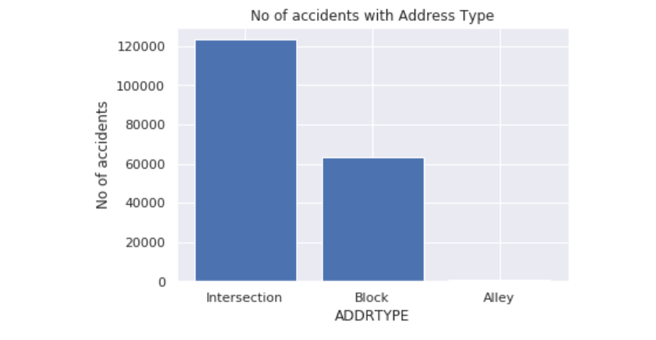

Slide 7
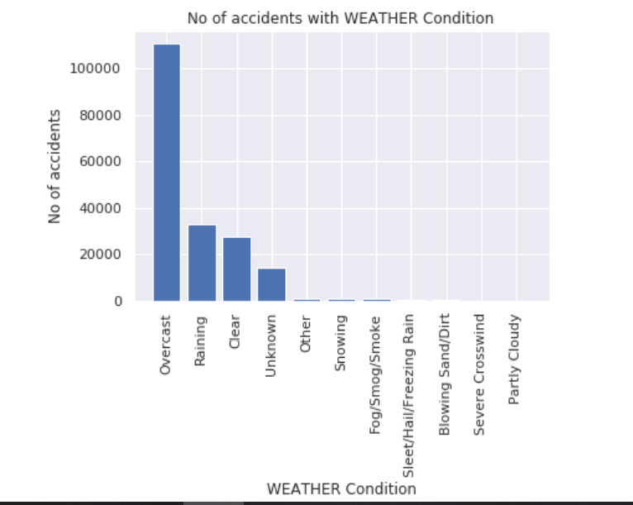

Slide 8
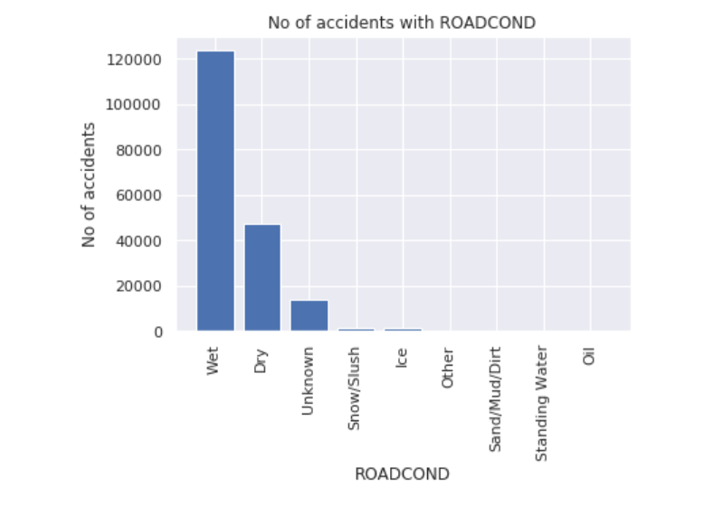

Slide 9
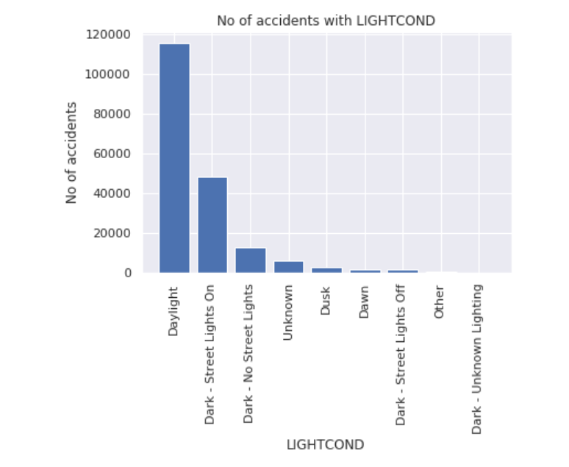

Slide 10
Conclusion
As we expected, the analysis supported the poor weather and road condition, intersection place increased the risk of car accidents but surprising the light didn’t impact much.
Seattle transportation department may need to collect more data for speeding drive and drunk driving, and further analyze if they have correlation with car accidents.
Most accidents involve some form of driver error but proper safety instructions will prevent and reduce the accidents and save the life.

Slide 11
References:
[1] https://www.macrotrends.net/cities/23140/seattle/population#:~:text=The%20current%20metro%20area%20population%20of%20Seattle%20in,was%203%2C379%2C000%20%2C%20a%201.2%25%20increase%20from%202017.
[2] https://www.currentresults.com/Weather-Extremes/US/cloudiest-cities.php

